Slide 1
Digital Electronics
Lab *: Number System Conversions

Slide 2


Welcome to Digital Electronics Class

Slide 3

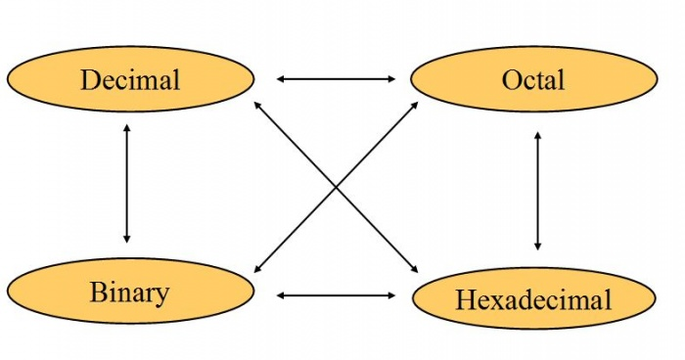
Number System Conversions
There are three types of conversion:
Decimal Number System to Other Base
Other Base to Decimal Number System
Other Base to Other Base

Slide 4
NS Conversions
Decimal Number System to Other Base
Divide the Number (Decimal Number) by the base of target base system (in which you want to convert the number: Binary (2), octal (8) and Hexadecimal (16)).
Write the remainder from step 1 as a Least Signification Bit (LSB) to Step last as a Most Significant Bit (MSB).

Slide 5
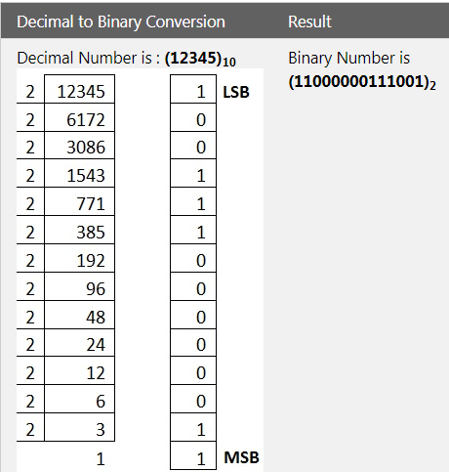
Decimal to Binary Conversion

Slide 6
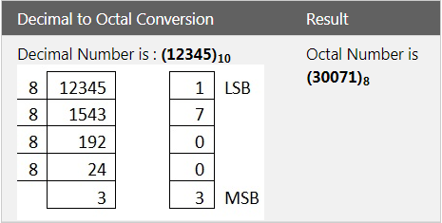
Decimal to Octal Conversion

Slide 7
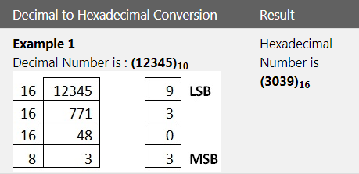
Decimal to Hexadecimal Conversion

Slide 8
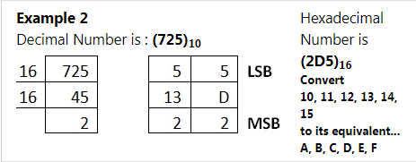
Decimal to Hexadecimal Conversion

Slide 9

Thank You!

